Slide 1
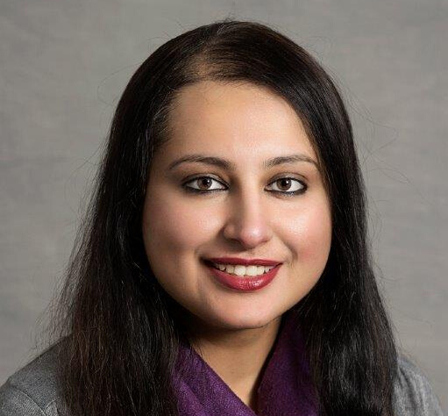
PAKISTAN’S HEALTHCARE TRAINING; Challenges and Opportunities
Wednesday 2nd Dec 2020:
9.30 am GMT (14.30 pm PST)
More Details and tickets from Eventbrite
We will add this later
LUNCHTIME LECTURE SERIES WEEK XX (2022)
We will add this later
Do not move logos or styling, please just alter text and photos, photos must be of high quality and as head shots
MADIHA SAJID (Chair)
UCL Athena Forum chair
UPSIGN Education Lead
DR GURNAM SINGH
Ass Prof of Equity
Coventry University
DR TAMJID MUJTABA
Senior Research Associate,
Institute of Education, UCL
@UPSIGN_Network

Slide 2
PAKISTAN’S HEALTHCARE TRAINING; Challenges and Opportunities
Wednesday 2nd Dec 2020:
9.30 am GMT (14.30 pm PST)
More Details and tickets from Eventbrite
https://www.eventbrite.co.uk/e/the-untold-story-impact-of-covid-19-on-bame-students-tickets-106162069608
LUNCHTIME LECTURE SERIES WEEK XX (2022)
MADIHA SAJID (Chair)
UCL Athena Forum chair
UPSIGN Education Lead
DR GURNAM SINGH
Ass Prof of Equity
Coventry University
DR TAMJID MUJTABA
Senior Research Associate,
Institute of Education, UCL
@UPSIGN_Network

